Slide 1





Auction Management System(AMS)
Name: Yadav Rohit Krishna Kumar
Branch: CE Roll No:245

Slide 2





Agenda

Slide 3

Introduction
Welcome to our presentation on Auction Management Systems (AMS).
Auction management refers to the process of planning, organizing, and overseeing auctions, where goods or services are bought and sold through a competitive bidding process.
Efficient auction systems are crucial for various industries, including e-commerce, finance, and art, as they ensure fair pricing, competition, and revenue maximization.
3
This Photo by Unknown Author is licensed under CC BY

Slide 4

Project Features
1.Count of Auctions
2.Avg.Bid
3.Cureent Bid for specific Category
4.Show time of Auctions
5.Insert and Delete Data
6.Update data and biddings
7.Serch data
4

Slide 5
What is Use of AMS ?
An Auction Management System is a software application or platform designed to facilitate and streamline the process of conducting auctions. Its primary purpose is to manage, coordinate, and optimize various aspects of auctions, whether they are traditional, online, or live events. Here are some common uses and benefits of an Auction Management System
Efficient Auction Execution
Increased Bidding Activity
Item Management
Bidding Process Automation
Real-time Updates
Auction Analytics
Time Management
Reporting and Record-keeping
5

Slide 6



Designing an AMS
Database Schema Design:
The foundation of our auction management system begins with a well-defined database schema
Data Tables:
User Tables
Items Tables
Auction Tables
Bids Table
6

Slide 7

Conclusion
Some Disadvantages like
Technical Complexity
Training
Maintenance and Updates
Customization Complexity
7

Slide 8
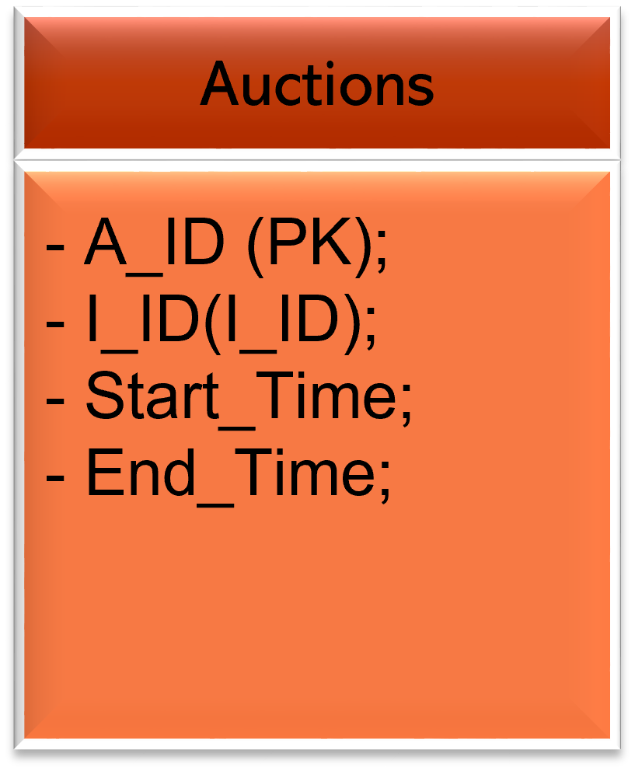
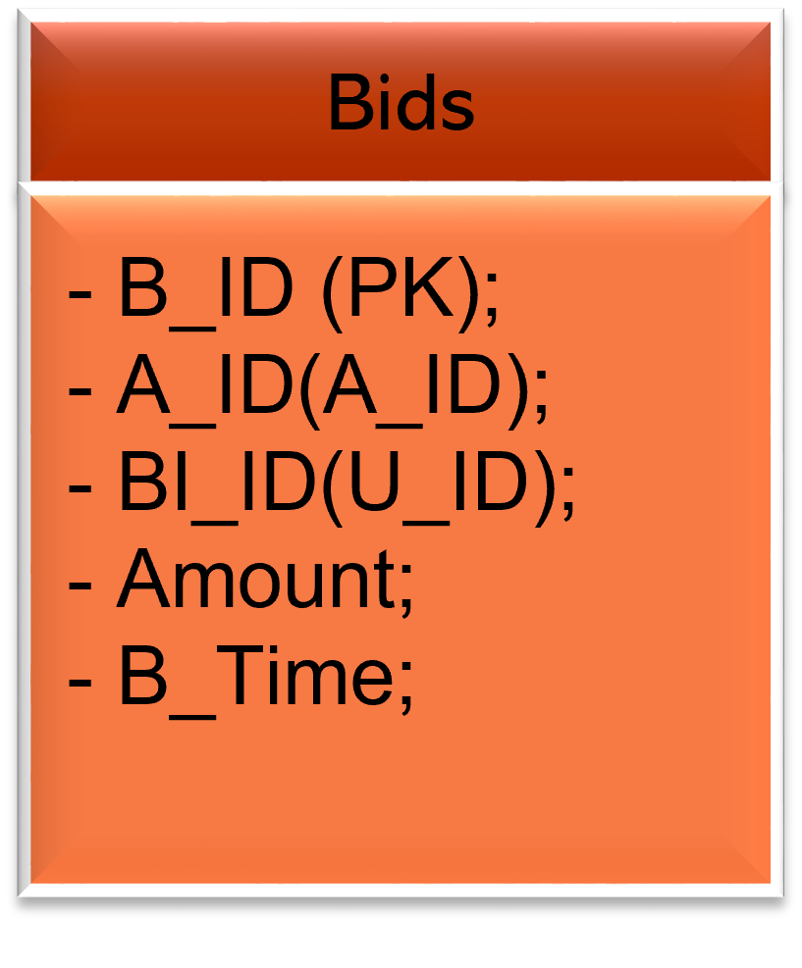
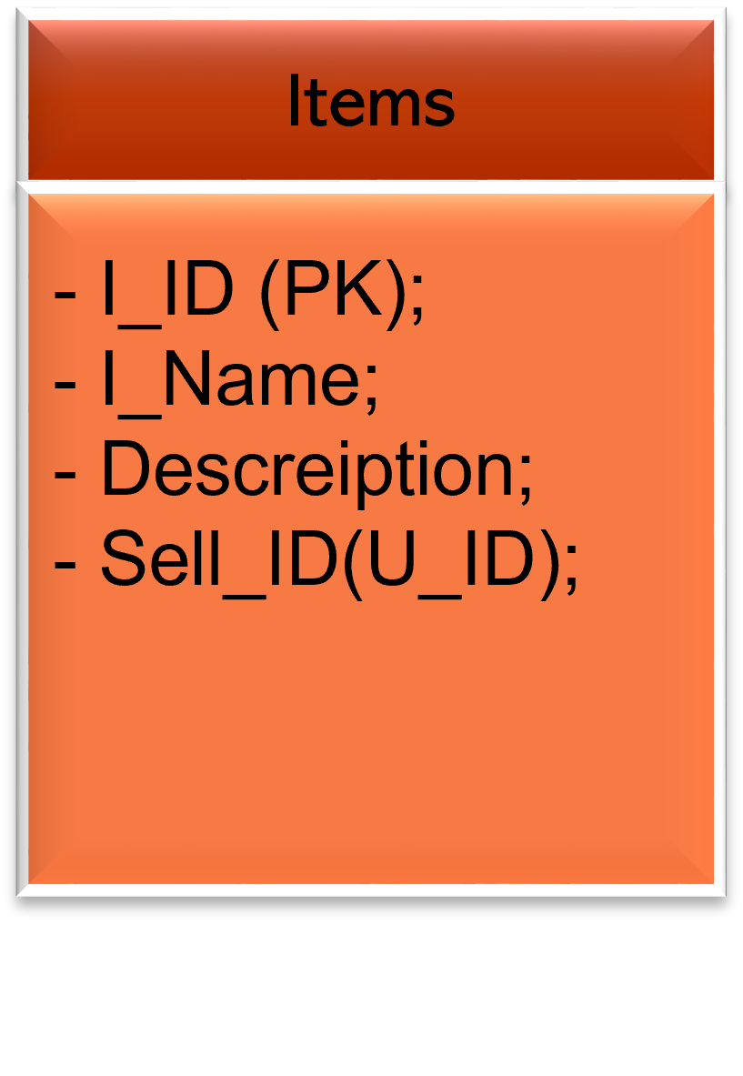
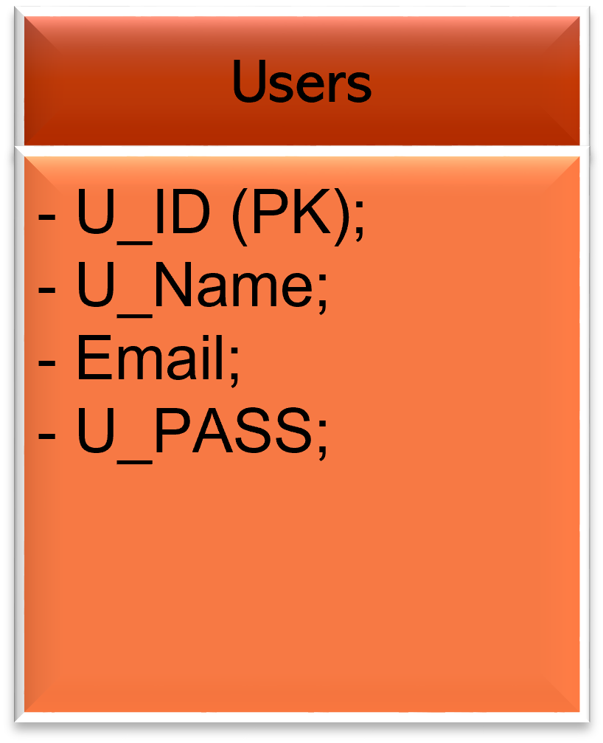
Tables:

Slide 9
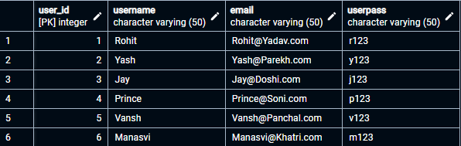
User Table:

Slide 10
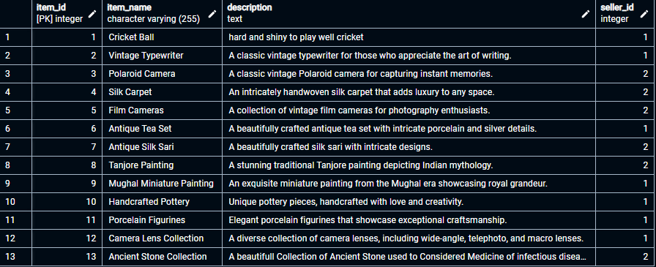
Items Table:

Slide 11
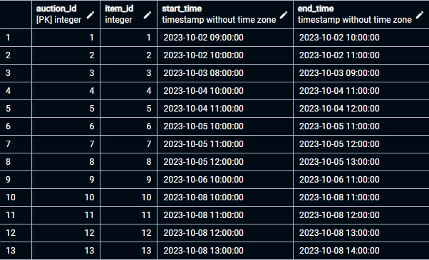
Auction Table:

Slide 12
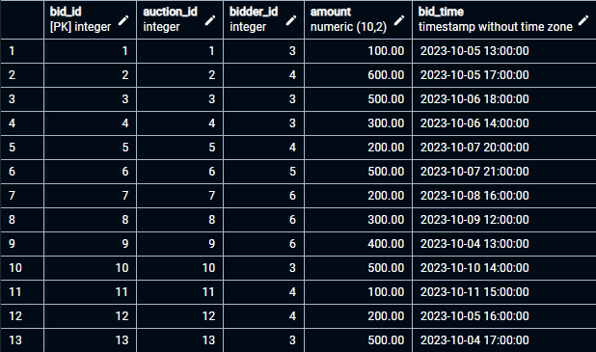
Bids Table:

Slide 13


